Slide 1

Vanessa CHARLES
Customer churn analysis

Slide 2
Problem
Describe the business problem and define the analytic approach to solving the problem.
The problem of the telecom company is because of several rivals that are constantly trying to steal customers hence they lose their customers they automatically they lose money .
The stakeholders impacted by the problem are the company executives,the marketing team and the customer service team and the investors.
This is a huge problem for the company because losing customers is costly for any business, as it can directly affect the profitability of the company.

Slide 3
Methodology
We work on a file of 7000 customers in Kaggle,come from the Telcocompany. We use Jupyter notebook to do the analysis, first we import all the libraries needed and we start with Data preprocessing which makes the information cleaner and more suitable to work.
And we start with the data analysis, Through data analysis, we will be able to make decisions about customer trends and behaviors, which will allow us to make effective decisions

Slide 4
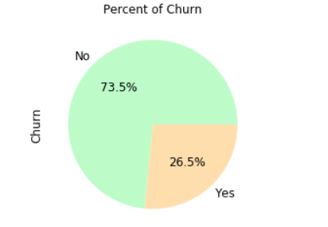
Impact of the Churn
There are about 26.54% of the customers churned
and 74.46% of the customers stayed.

Slide 5
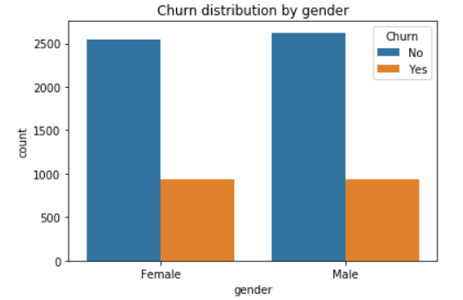
Customer demographics : Gender
From the plot, it looks like gender does not play a role in customer churn Almost as many
women as men have churned during the past
month.

Slide 6
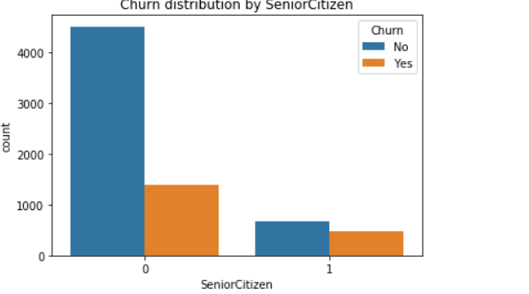
Customer demographics: Age

Slide 7
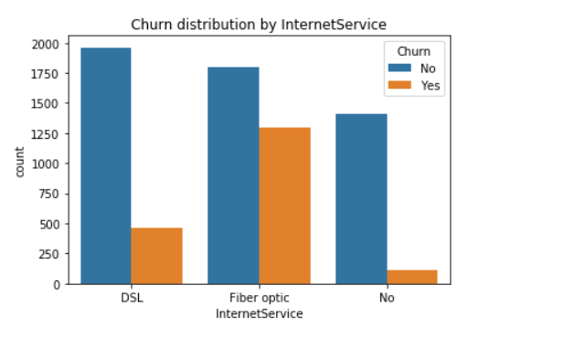
Services used : INTERNET
The chart above is interesting, because can help us to discriminate retained and churned customers, it shows that most customers that churned had the Fiber optic internet service, and the most customers that were retained had DSL internet service. Maybe the company should only provide DSL as the internet service or stop providing Fiber optics for it’s internet service.

Slide 8
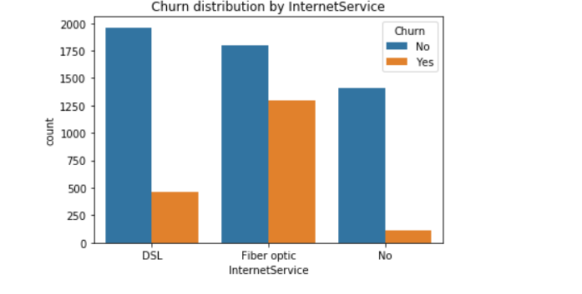
ervices typically purchased by customers who churned

Slide 9
Bonus
The company's going to take about 29 months to lose all his clients.
They will lose the demographics independent first because they the will churn in 5 months

Slide 10
Discussion & Recommendations
My proposed solution: In light of competition in the market, which is one of the main causes of the churn, after identifying other reasons why customers have left, the telecom company could innovate its services to make changes that will be much more responsive to customer requirements within the carrier to be able to satisfy them much more.

Slide 11
Discussion & Recommendations
What are strengths of the organization that you have leveraged in your solution?
The company has a certain renown in the market as it has been in existence for several years.
The company has a massive market share.
What are weaknesses of the organization that could undermine your solution?
it's hard for the company to get new customers.
What are challenges that you might encounter? How can you mitigate them?

Slide 12
References & Appendices
Provide citations for your work and provide resources for your audience to learn more about the technical aspects of your project. Share links to your GitHub repository or accompanying spreadsheets.

